Slide 1
Intentions and Plans
Toward foundations for an ontology of intentions and plans
Alec Sculley 2/15/24

Slide 2
Agenda
Lit review/Goal
Driving example/Imports
Ontology of intentions
Ontology of plans
Cases

Slide 3
Lit Review
Philosophy and cognitive science
An exclusive focus on intentions and mental plans
Artificial intelligence
An exclusive focus on non-mental plans
Both
make no clear or consistent distinction between intentions and plans

Slide 4
Plans in BFO conformant ontologies
cco:Plan is a “directive information content entity that prescribes some set of intended intentional acts through which some agent expects to achieve some objective.”
iof:Plan is an “intention-to-perform processes on the part of an agent as prescribed by a plan specification.”
obi:Plan is a “realizable entity that inheres in a bearer who is committed to realizing it as a planned process.”

Slide 5
Goal
Provide a clear distinction between intentions and plans that accounts for
the relationship between intentions and plans &
plans generally

Slide 6
Agenda
Lit review/Goal
Driving example/Imports
Ontology of intentions
Ontology of plans
Cases

Slide 7
Driving example
Jim’s intentions and plans
Jim forms an intention to have answer to question
Jim forms an intention to query database
—————-
Jim must represent his intentions such that they are editable, expandable and otherwise transformable
Jim must transform his plan so that it can be executed

Slide 8
ME
ICE
PROC
Q

Slide 9
Imports
Mental Quality
cpo:Representation
Mental representation
Conative representation
bfo:has_part
bfo:concretizes
bfo:inheres_in
cco:prescribes
cco:represents
cco:causes
cpo:is_fused_with

Slide 10
Agenda
Lit review/Goal
Driving example/Imports
Ontology of intentions
Ontology of plans
Cases

Slide 11
a commitment value is a mental quality that, when fused with a mental representation MR, determines the extent to which a cognitive system operates as if MR is controlling.
a positive commitment value is commitment value that when fused with a mental representation MR results in the bearing cognitive system treating MR, to some extent, as if it were controlling.

Slide 12
INTENTION
CR = conative representation
PCV = positive commitment value
PROC
prescribes
DICE
is_concretized_by
CR
PCV
is_fused_with
Notes:
Intentions as species of desire

Slide 13
OBJECTIVE INTENTION
OBJ
prescribes
DICE
is_concretized_by
INT

Slide 14
Jim’s Objective Intention
Jim’s intention to query a database
CR = conative representation
PCV = positive commitment value
DICE1
Having answer 1
prescribes
PCV1
is_concretized_by
is_fused_with
CR1
Cognitive System1
Jim1
inheres_in
is_part_of

Slide 15
ACTION INTENTION
ACT
prescribes
DICE
is_concretized_by
INT

Slide 16
Jim’s Action Intention
Jim’s intention to code
CR = conative representation
PCV = positive commitment value
DICE2
Querying1
prescribes
is_concretized_by
PCV2
is_fused_with
CR2
Cognitive System1
Jim1
inheres_in
is_part_of

Slide 17
Jim has two intentions
Intention to have answer to question
Intention to query database

Slide 18
Agenda
Lit review/Goal
Driving example/Imports
Ontology of intentions
Ontology of plans
Cases

Slide 19
PLAN COMPONENT
RICE
represents
is_concretized_by
INT
REP

Slide 20
TWO PLAN COMPONENTS
RICE1
RICE2
is_concretized_by
is_concretized_by
represents
represents
CR1
REP1
REP2
CR2

Slide 21
, By Oo
Have answer
Query database

Slide 22
PLAN
PC = plan component
RC = representation complex
RC
PC
has_part

Slide 23
CR = conative representation
RC = representation complex
PLAN
RICE1
RICE2
is_concretized_by
is_concretized_by
represents
represents
CR3
REP1
REP2
CR4
has_part
RC1
has_part

Slide 24
Have answer
Query database

Slide 25
HIERARCHICAL PLAN
PC = plan component
RC = representation complex
HV = hierarchy value
RC
PC
HV
has_part
is_fused_with

Slide 26
Have answer
1.0.
Query database
1.1.

Slide 27
Have answer
1.0.
Query database
1.1.
Write SPARQL query
1.1.1.

Slide 28
Have answer
1.0.
Query database
1.1.
Write SPARQL query
1.1.1.
Write SELECT function
1.1.1.1.
Write COUNT function 1
1.1.1.2.
Write FILTER function
1.1.1.3.
Write COUNT function 2
1.1.1.4.

Slide 29
Have answer
1.0.
Causes
Query database
1.1.
Precedes
1.1.1.
Write SPARQL query
1.1.1.1.
Constitutes
1.1.1.2.
Write SELECT function
Write FILTER function
1.1.1.3.
Write COUNT function 1
Write COUNT function 2
1.1.1.4.

Slide 30
Agenda
Lit review/Goal
Driving example/Imports
Ontology of intentions
Ontology of plans
Cases

Slide 31

To-do List
A non-hierarchical plan of actions
Represents writer’s action intentions
Notes:
Deceiving labels. Are “plans” as used by cco the same as my plans?

Slide 32
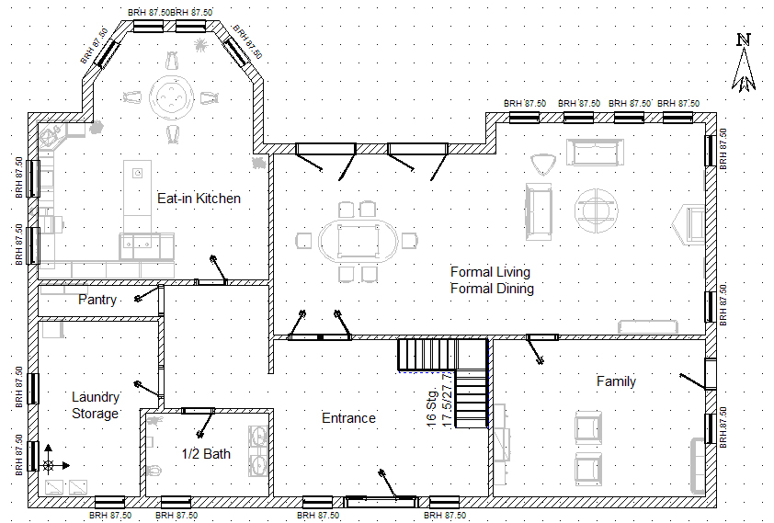
Blueprint/Floor Plan
A non-hierarchical Plan of objectives
Represents designer’s objective intentions to have at least one home built according to the specifications

Slide 33
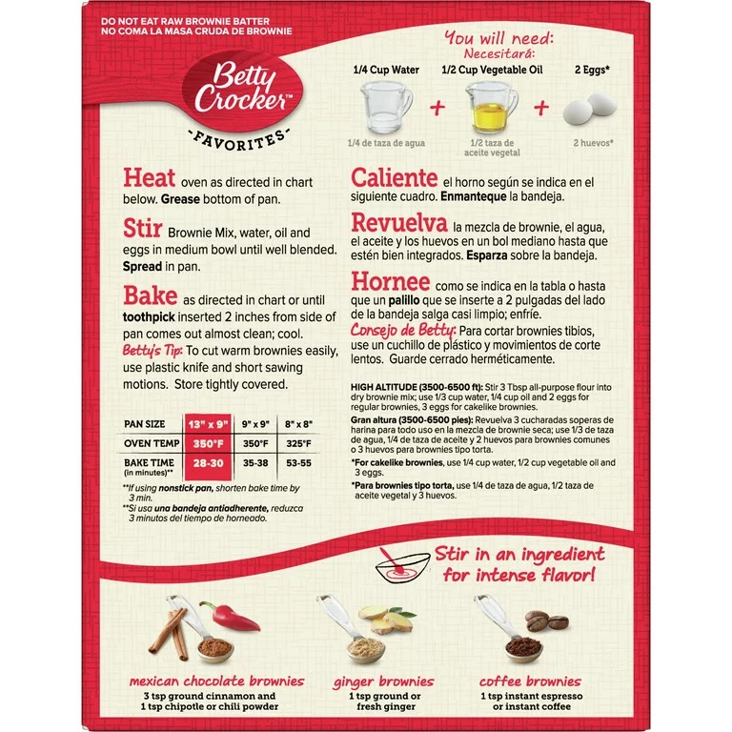
Recipe
A hierarchical plan
Represents Betty Crocker’s action intentions and objective intentions for customers to bake brownies.

Slide 34

Software
Commands that represent coder’s intentions for computer

Slide 35
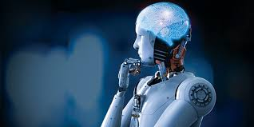
Plans and AI

